Slide 1


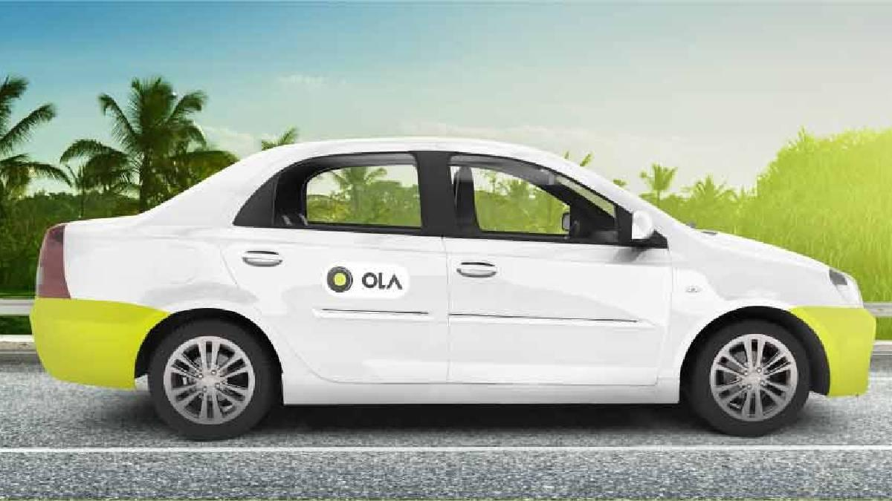
Studio Shodwe
OLA ELECTRIC MOBILITY PVT LTD.
www.olacabs.com

Slide 2
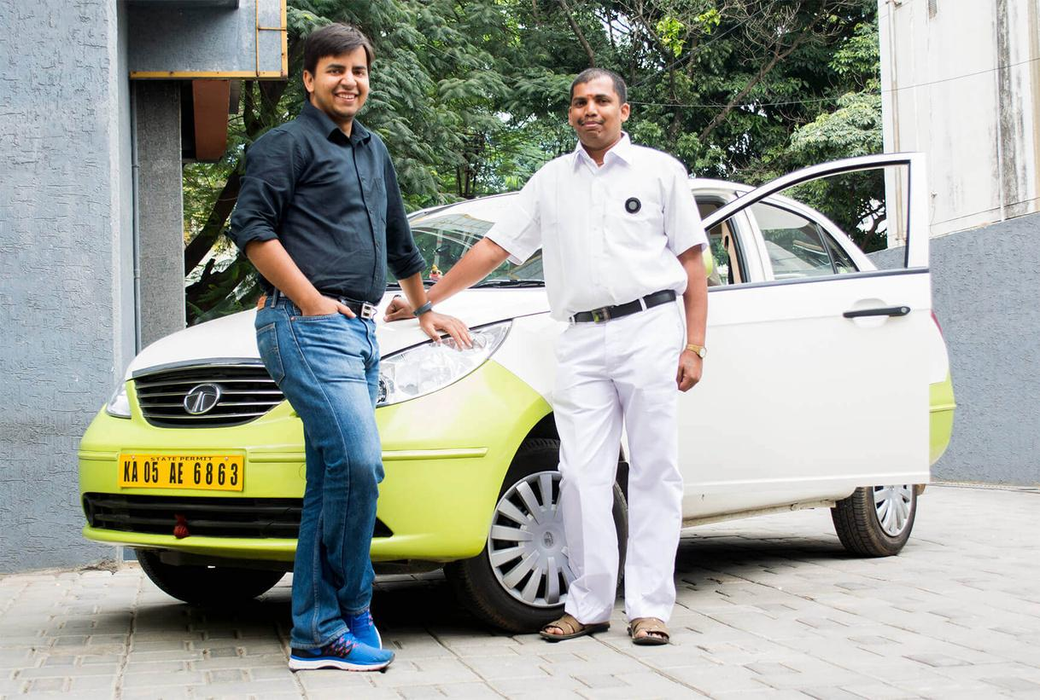

OLA COMPANY
Ola is the biggest mobility platform in India and among the largest ride-hailing firms globally, operating in over 250 cities throughout India, Australia, New Zealand, and the UK. The Ola app provides mobility options by linking customers with drivers and a variety of vehicles including bikes, auto-rickshaws, metered taxis, and cabs, ensuring convenience and transparency for hundreds of millions of users and more than 1.5 million driver-partners.

Slide 3




Objective
To analyze Ola’s ride data for insights into customer behavior, vehicle efficiency, and operational challenges.
To identify patterns in ride cancellations, booking success rates, and geographical demand.
To provide data-driven recommendations to optimize Ola’s services and enhance customer experience.

Slide 4

Key Findings
The number of successful bookings is 63,967, exceeding the cancellation count of 28,933.
The most common reason for canceling bookings by the driver is a “Personal & Car related issue” and by the customer is “Driver is not moving towards personal location”.
The driver has rated the Prime SUV and E-bike at the highest level, while the customer has given the top rating to the Prime Plus vehicle which is 4.01.
The highest revenue comes from cash payments, while debit cards are the least utilized payment method.
According to total distance travel data, Customers primarily favor Prime Sedan and E-Bike, followed by Bike, Prime Plus, Mini, Prime SUV, and Auto.

Slide 5


Recommendation
Implement strategy for cancellation rides:
Implement a system to monitor driver cancellations due to personal and car issues, offer support like vehicle maintenance or incentives, improve driver navigation algorithms, and allow customers to choose alternate nearby drivers.
Focus on other vehicles
Ola company must focus on Bike, Prime Plus, Mini, Prime SUV, and Auto vehicles to maintain its customer satisfaction, boost the ride experiance and attract new customers.
For this, company can investigate customer feedback on above vehicles to understand key improvement areas .
Optimize Revenue Streams:
Ola should enhance cash-handling policies and promote digital payment options like debit cards through cashback incentives, discounts, or reward programs to increase usage and reduce cash dependency.

Slide 6
Studio Shodwe
THANK
YOU
reallygreatsite.com

